Slide 1
Multi-Year
Budget Projections
Presentation to the
De Anza College Council
June 12, 2014
Kevin McElroy, Vice Chancellor, Business Services
Hector Quinonez, Executive Director, Fiscal Services
Joni Hayes, Director, Budget Operations

Slide 2
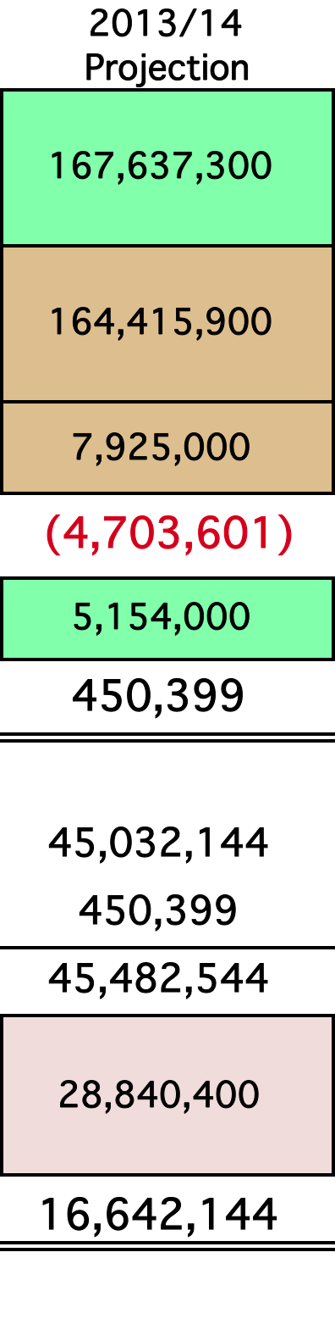
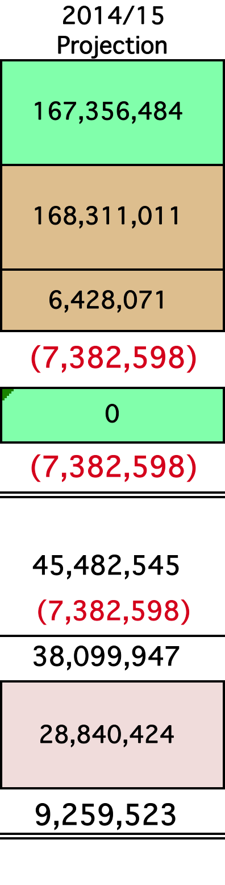
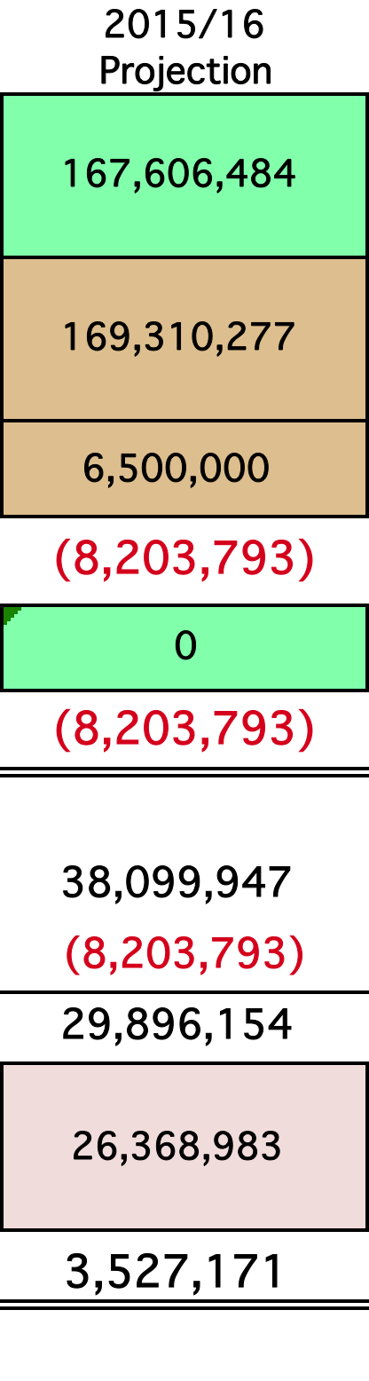
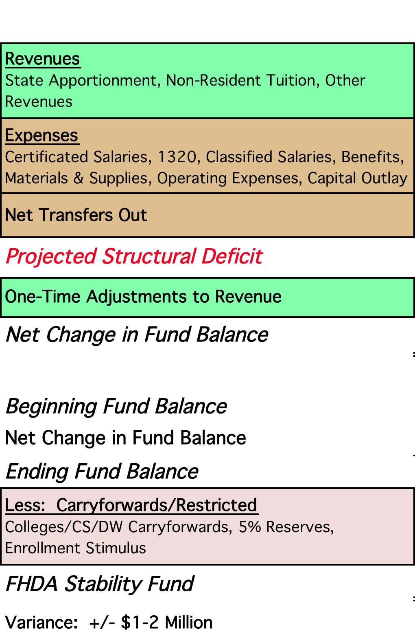
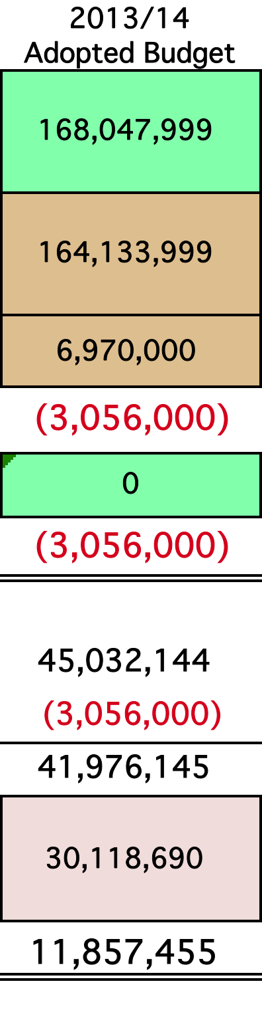
Foothill-De Anza Community College District Multi-Year Projections for the
General Purpose Fund (Fund 114)

Slide 3

Thank you for your time.
Questions?
BIG CHALLENGES AHEAD….
BUT WE HAVE PREPARED WELL TO THOUGHTFULLY DEVELOP OUR PLANS GOING FORWARD.
Contact: Kevin McElroy, Vice Chancellor, Business Services mcelroykevin@fhda.edu
Contact: Hector Quinonez, Executive Director, Fiscal Services
quinonezhector@fhda.edu
Contact: Joni Hayes, Director, Budget Operations
hayeslampreyjoni@fhda.edu

