Slide 1
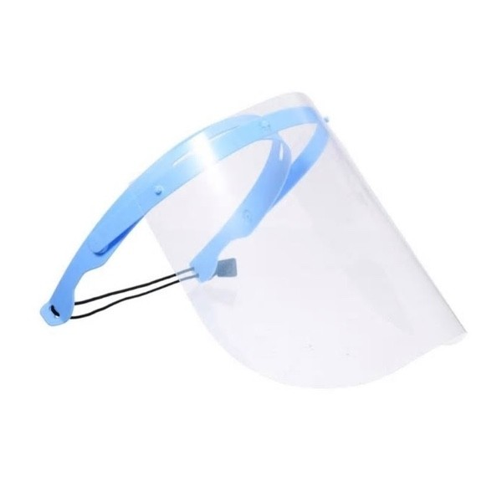
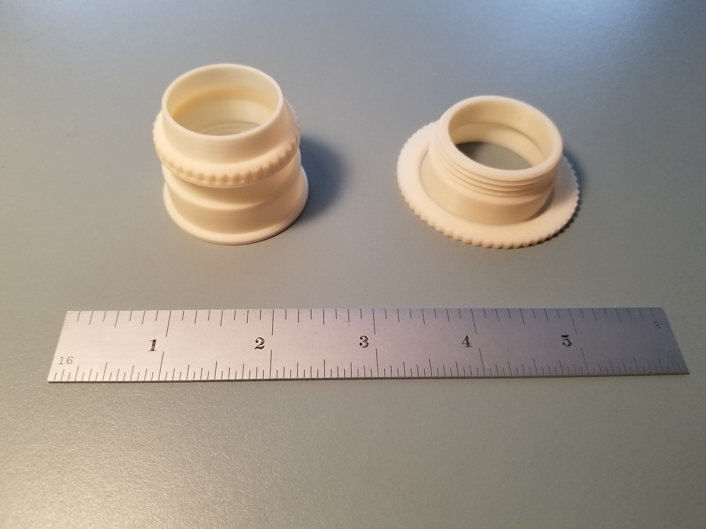
De Anza 3D Printing Group Expands its COVID-19 Manufacturing Effort – May 29, 2020
Since partnering with local non-profit Maker Nexus, over 40,000 of face shields were delivered with orders pending for 11,000.
To date, the De Anza team has printed over 6000 parts for Maker Nexus.

Slide 2
Division of Business, Computer Science & Applied Technologies
Accounting (2 Certificate, 1 AA)
Payroll noncredit certificate is a possibility (CTE)
Automotive Technologies
Day Program (3 Certificates, 3 AS)
Evening Program (13 Certificates, 4 AS)
Noncredit certificate in SMONG
Business (6 certificates, 4 AA&AS) – ADT
CTE Certificate in Business Information Worker (should look into noncredit)
Computer Science (17 certificates, 6 AS) – ADT.
Noncredit – Project Management
Design and Manufacturing Technologies (7 certificates, 3AS)
Real Estate (1 certificate, 1 AA)
New Sales Certificate (3 courses)
Noncredit Certificate – DRE Approval!!!

Slide 3
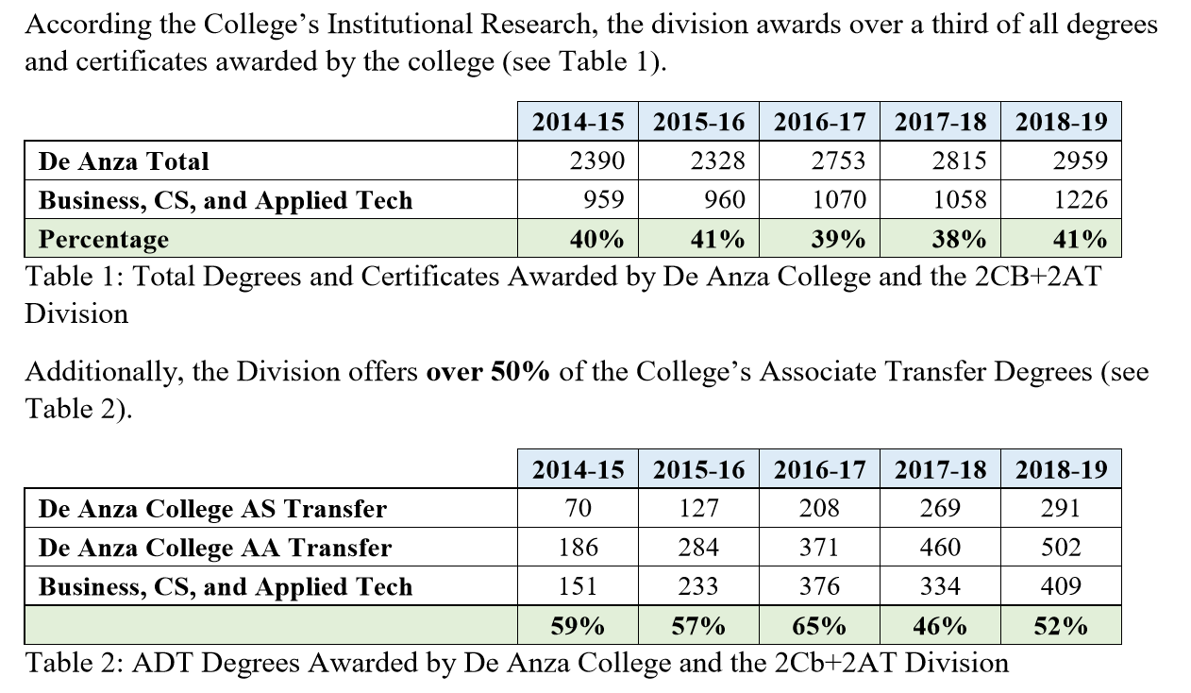

Slide 4
The college MUST invest in creating a way to alert students and award certificates when completed

Slide 5
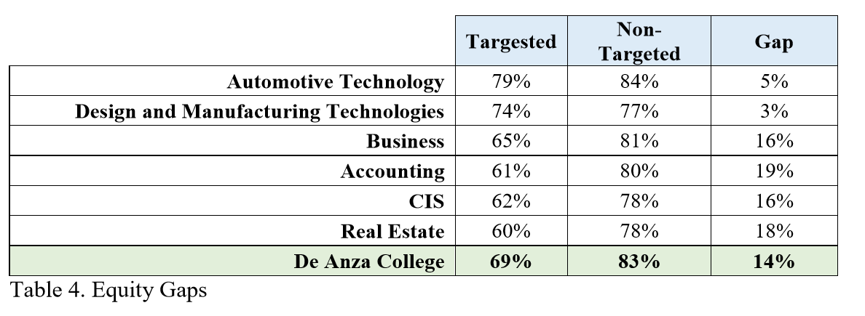
Engaging Faculty in Closing the Equity Gap IS A Challenge.
Could it be a core part of:
Sabbaticals
Professional Development
PAA/PGA
Challenges
English
Basic Math

Slide 6
COVID IMPACT
Deeply concerned about the student success and the equity gap.
There is a digital divide where some people do not have access to adequate internet speeds or the relevant technology and so they will be missing out.
Deeply concerned about having students set in a FOUR HOURS Zoom session (especially 6:00PM to 9:50PM)
Significant drop in Applied Technology enrollment.
35% of the students surveyed will not return next year if classes continue to be online/Zoom
https://www.insidehighered.com/advice/2020/04/22/professor-explores-why-zoom-classes-deplete-her-energy-opinion

Slide 7
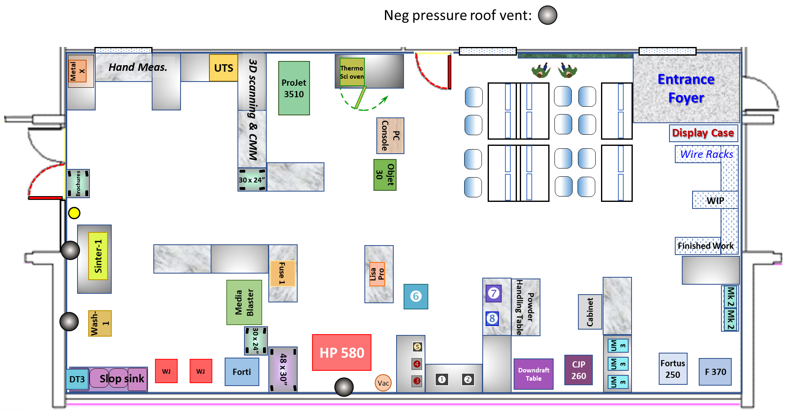

Slide 8
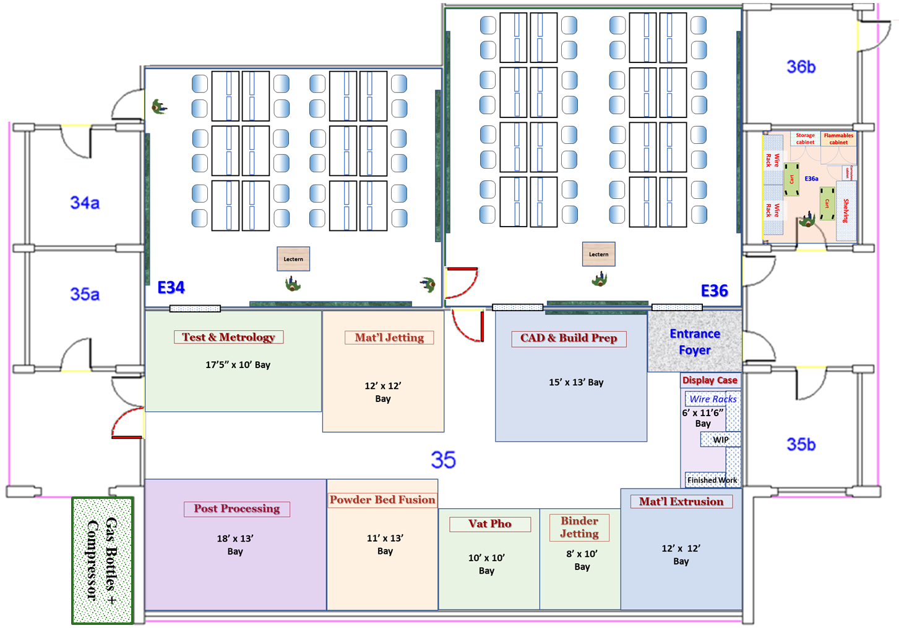

Slide 9
Investment
Approximately $996,310

